Slide 1
Cocoa Krispie Mobile
Presentation and Car by
Kenny Blum
Annabel Milliner
Franny Mancillas
Ethan Rapp

Slide 2
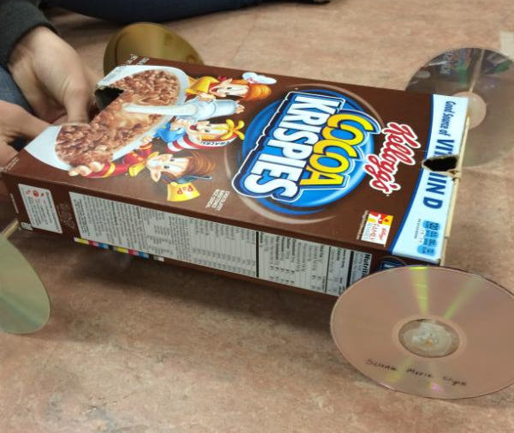
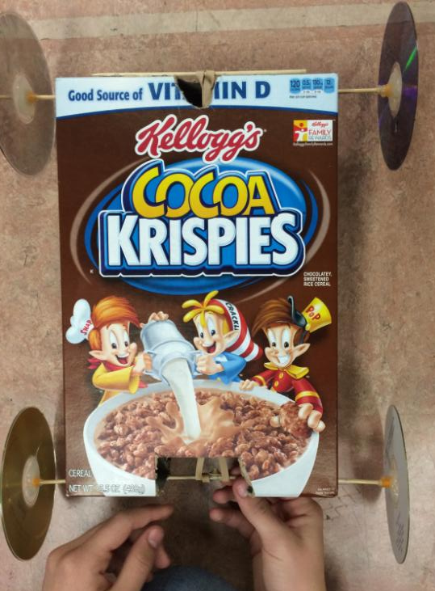
Details
Powered using rubber bands
Has a mass of 0.145 kilograms
With the weights, it has a mass of 0.395 kilograms
The rubber band used in the car has a Spring Constant of 19.406
Will drive 5 meters in about 11.5 seconds
Is super cool

Slide 3
Materials
Rubber Bands
CD’s
Cereal Box
Straws
Wooden Sticks
Scissors (to make cuts)
Hot Glue Gun + Hot Glue Sticks

Slide 4
Why Should You Use This Design?
Our Rubber Band Powered Car is the best design to use because:
Attractive
Very cheap to build
Very easy to build
Great for the environment
Doesn’t cost money to use
Durable and long-lasting
In the case it does break down, it is easily repairable
Can be styled easily to fit your customer’s preference (you can use your favorite cereal box)

Slide 5
Collected Data
Distance (m) | Time (s) | ∆ Time (s) | Velocity (m/s) |  | Potential Energy (J) | Kinetic Energy (J) | Thermal Energy (J)
0 | 0 | 0 | 0 | 0 | 6.604 | 0 | 0
1 | 0.99 | 0.99 | 1.01 | 1.02 | 2.361 | 0.074 | 4.169
2 | 2.22 | 1.23 | 0.813 | -0.16 | 0.932 | 0.048 | 5.624
3 | 4.23 | 2.01 | 0.498 | -0.157 | 0 | 0.018 | 6.586
4 | 6.51 | 2.28 | 0.439 | -0.026 | 0 | 0.014 | 6.59
5 | 11.41 | 4.90 | 0.204 | -0.048 | 0 | 0.003 | 6.601

Slide 6
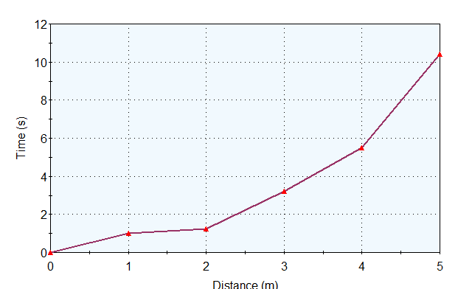
Time vs. Distance

Slide 7
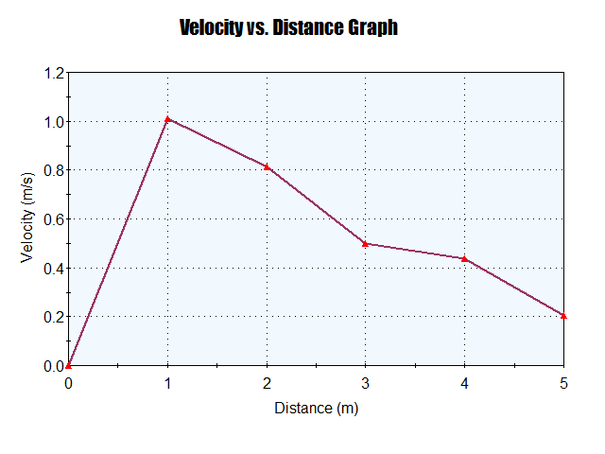
Velocity vs. Distance

Slide 8
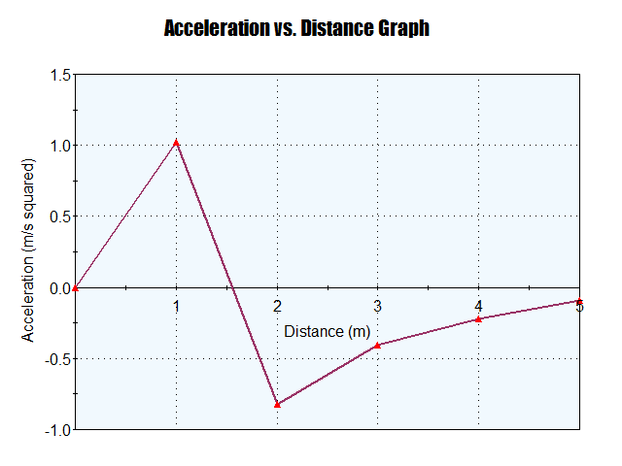
Acceleration vs. Distance

Slide 9
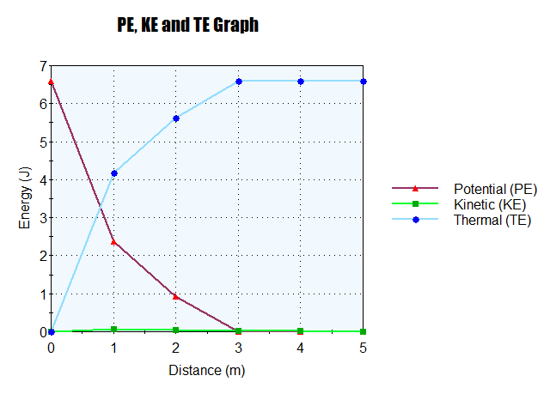
Pe, Ke and Te Graph

